Slide 1


GDP FORECASTING
By: Madiha Najam, Fatima Zahra El Mansouri,
Tanvir Rehman, Shehryar Siddiqui

Slide 2
PROJECT OVERVIEW:
Overview
Intro to Macroeconomics
Forecasting GDP
Conclusion

Slide 3
DATA
MINING
Datasets
Source
ETL

Slide 4
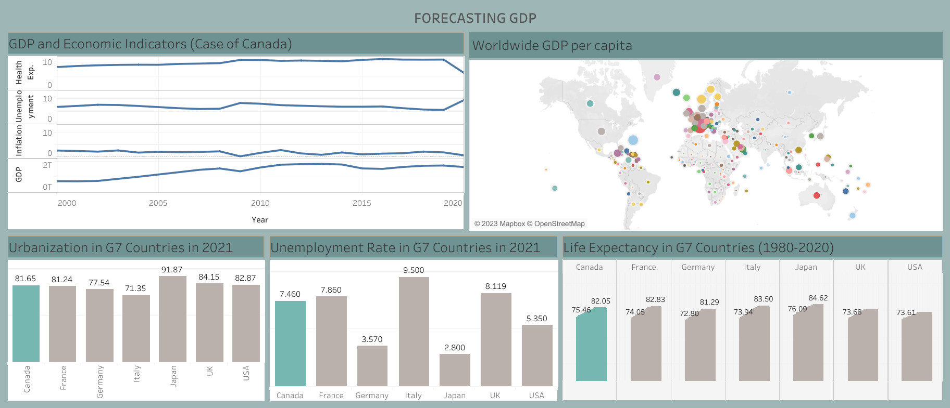
Exploring Canadian Data Tableau Dashboard

Slide 5
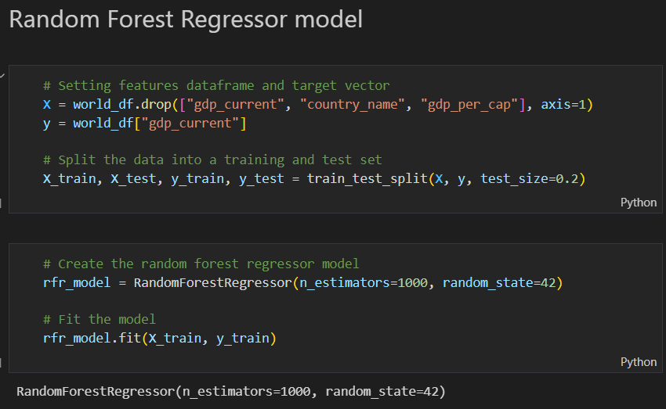
GDP FORECAST
MACHINE LEARNING MODELS
Multi Linear Regression
Support Vector Regression
Random Forest Regressor
Deep Learning

Slide 6
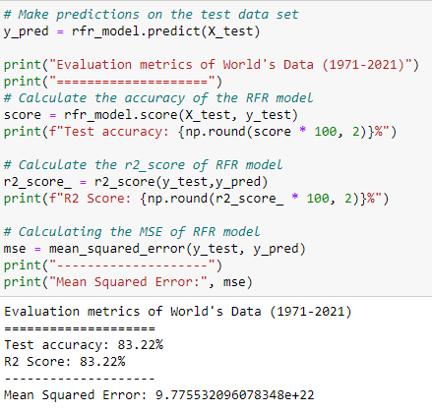
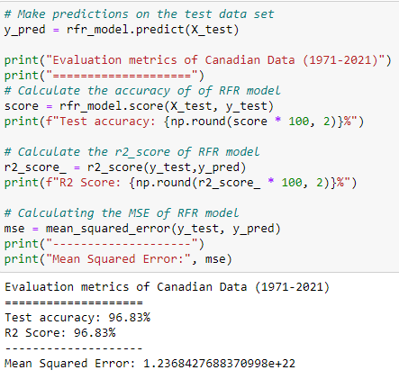
Tracking Accuracy
Evaluation Metrics
R2 Square
Mean Squared Error (MSE)

Slide 7
Conclusion:
Potential Research
Organizations
Government Policies
Business Investors

Slide 8

THANK YOU!

Slide 9
QUESTIONS?
Time to Butcher US!

